Slide 1

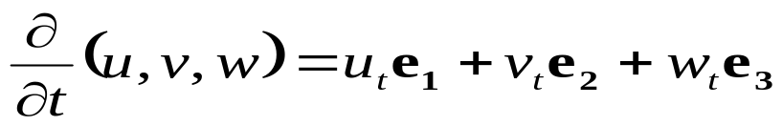
Navier Stokes Equations
Suppose there is a solution. Given the real number
R > 0, determine u, v, w, p(x,y,z,t) — four real functions from four real parameters — such that, letting F = G = H = 0, the 4 × 4 equation system holds:
u_{x} + v_{y} + w_{z} = 0
R(u_{xx} + u_{yy} + u_{zz}) + F = u_{t} + p_{x} + u_{x}u + u_{y}v + u_{z}w
R(v_{xx} + v_{yy} + v_{zz}) + G = v_{t} + p_{y} + v_{x}u + v_{y}v + v_{z}w
R(w_{xx} + w_{yy} + w_{zz}) + H = w_{t} + p_{z} + w_{x}u + w_{y}v + w_{z}w
Speed = Pressure = p
Acceleration =

Slide 2

Let’s isolate u from the fourth equation:
Now let’s replace u(v, w, p) in (2):

Slide 3
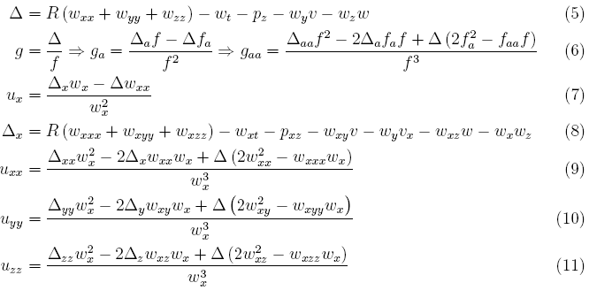

(2) implies that:

Slide 4
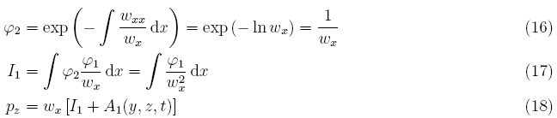
implies:
Let’s isolate p_{z}:
(14) solves an ODE by variation of parameters.

Slide 5
(3) implies:
Let’s emphasize p: [see (23)]
Let’s replace p_{z} from (18) and p_{y} from (103)
Don’t worry: (100-103) will be explained.

Slide 6

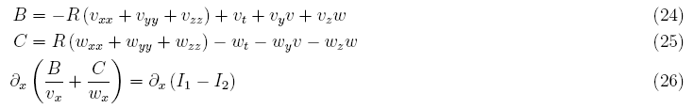
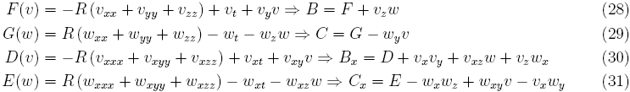
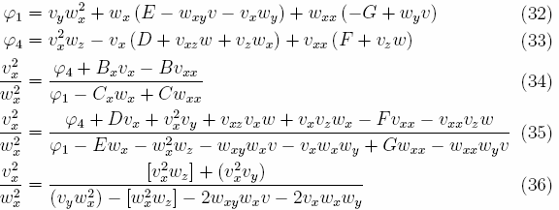
Let’s derivate on x equation (22)

Slide 7
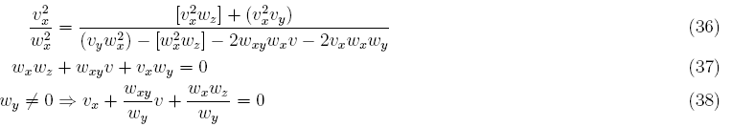

Simplifying:
Again, let’s use ODE-VoP:
Next page, we’re going to replace v(w) on (103).

Slide 8
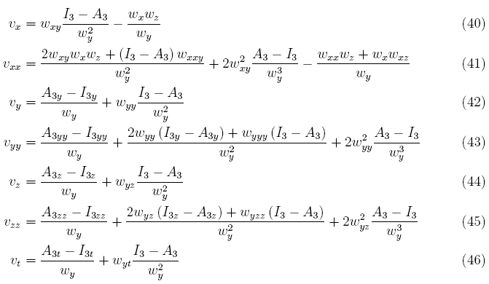

Slide 9
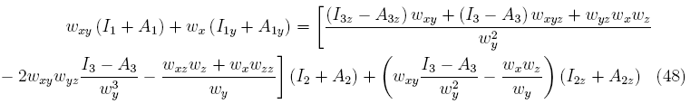
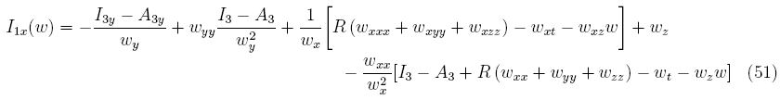
Now let’s join (18) and (103), setting p_{zy} = p_{yz}:
Well done. This is the first Integral Equation on w.
From v(w), the three integrals I₁, I₂ and
I_{3x}(w) = w_{x}w_{z} become:

Slide 10
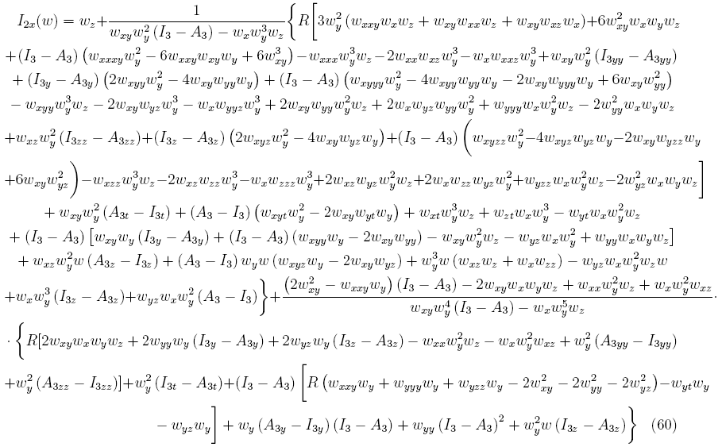

Slide 11
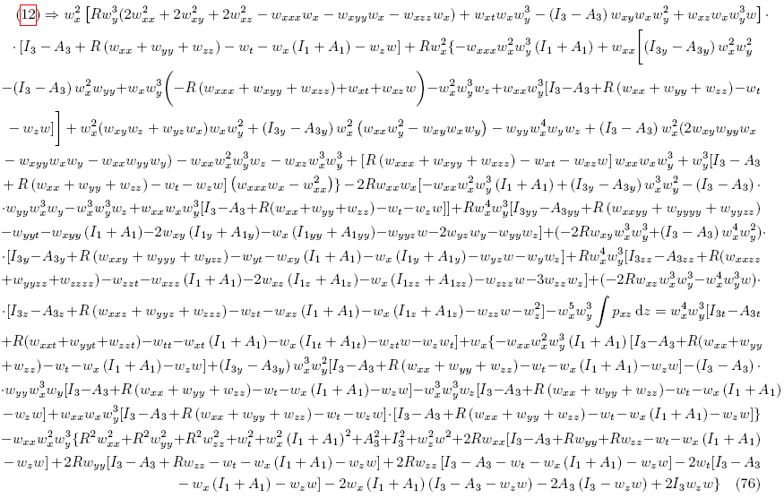
The second integral equation comes from (12):

Slide 12
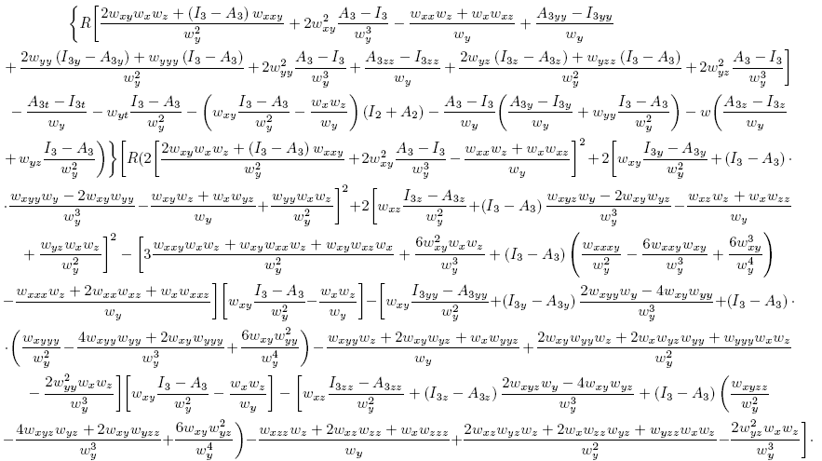
(97) implies the third 2-paged Int.Eq. on w. [1/2]

Slide 13
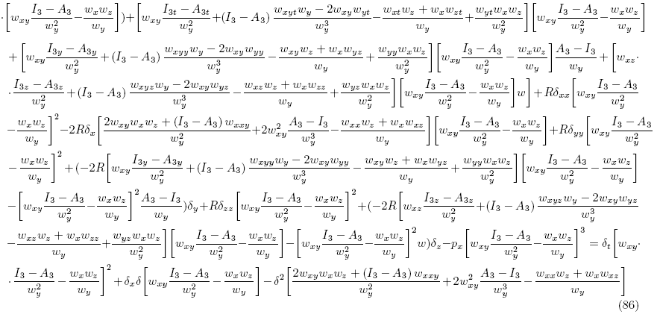
(97) implies the third 2-paged Int.Eq. on w. [2/2]

Slide 14
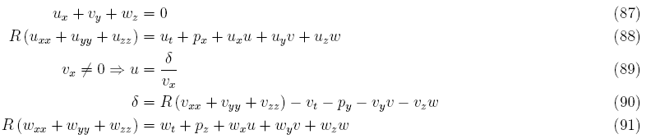
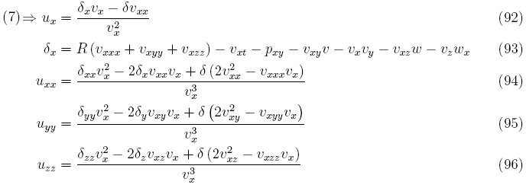
Finally, let’s explain equations > (86), by analogy.

Slide 15


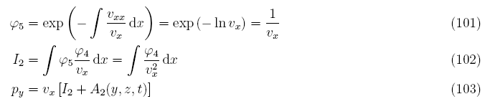
Thanks. boralaemcasa@gmail.com
https://sites.google.com/site/mathspirituality/
This was a help for StokeNav.pdf

Slide 16
Map
(1), (4) ==> (13) v, w, p ==> (14) p_{z}(v, w) ==> (18) p_{z}(v, w)
(15) is part of (18)
(2), (4) ==> (12) v, w, p
(3), (4) ==> (19) v, w, p ==> (20)
(1) <==> (87)
(2) <==> (88)
(3), v_{x} ≠ 0 ==> (89) u(v, w, p)
(88), (89) ==> (97) v, w, p
(87), (89) ==> (98) v, w, p ==> (99) p_{y}(v, w) ==> (103) p_{y}(v, w)
(100) is part of (103)
(91), w_{x} ≠ 0 ==> (4) u(v, w, p)
(18), (103), (20), v_{x} ≠ 0 ==> (21) v, w ==> (22) ==> (26)
(26) ==> (27) ==> (34) ==> (35) ==> (36) ==> (37)
(37), w_{y} ≠ 0 ==> (38) ==> (39) v(w)
(39), (103) ==> (47) p_{y}(w)
(15), v(w) ==> (51) I₁(w)
(100), v(w) ==> (60) I₂(w)
(18), (103), p_{zy} = p_{yz} ==> (48) w
(12), v(w), p(w) ==> (76) w
(97), v(w), p(w) ==> (86) w

